Slide 1
Modern GPU Architecture
CSE 694G
Game Design and Project
Prof. Roger Crawfis

Slide 2
GPU vs CPU
A GPU is tailored for highly parallel operation while a CPU executes programs serially
For this reason, GPUs have many parallel execution units and higher transistor counts, while CPUs have few execution units and higher clockspeeds
A GPU is for the most part deterministic in its operation (though this is quickly changing)
GPUs have much deeper pipelines (several thousand stages vs 10-20 for CPUs)
GPUs have significantly faster and more advanced memory interfaces as they need to shift around a lot more data than CPUs

Slide 3
The GPU pipeline
The GPU receives geometry information from the CPU as an input and provides a picture as an output
Let’s see how that happens
host
interface
vertex
processing
triangle
setup
pixel
processing
memory
interface

Slide 4
Host Interface
The host interface is the communication bridge between the CPU and the GPU
It receives commands from the CPU and also pulls geometry information from system memory
It outputs a stream of vertices in object space with all their associated information (normals, texture coordinates, per vertex color etc)
host
interface
vertex
processing
triangle
setup
pixel
processing
memory
interface

Slide 5
Vertex Processing
The vertex processing stage receives vertices from the host interface in object space and outputs them in screen space
This may be a simple linear transformation, or a complex operation involving morphing effects
Normals, texcoords etc are also transformed
No new vertices are created in this stage, and no vertices are discarded (input/output has 1:1 mapping)
host
interface
vertex
processing
triangle
setup
pixel
processing
memory
interface

Slide 6
Triangle setup
In this stage geometry information becomes raster information (screen space geometry is the input, pixels are the output)
Prior to rasterization, triangles that are backfacing or are located outside the viewing frustrum are rejected
Some GPUs also do some hidden surface removal at this stage
host
interface
vertex
processing
triangle
setup
pixel
processing
memory
interface

Slide 7
Triangle Setup (cont)
A fragment is generated if and only if its center is inside the triangle
Every fragment generated has its attributes computed to be the perspective correct interpolation of the three vertices that make up the triangle
host
interface
vertex
processing
triangle
setup
pixel
processing
memory
interface

Slide 8
Fragment Processing
Each fragment provided by triangle setup is fed into fragment processing as a set of attributes (position, normal, texcoord etc), which are used to compute the final color for this pixel
The computations taking place here include texture mapping and math operations
Typically the bottleneck in modern applications
host
interface
vertex
processing
triangle
setup
pixel
processing
memory
interface

Slide 9
Memory Interface
Fragment colors provided by the previous stage are written to the framebuffer
Used to be the biggest bottleneck before fragment processing took over
Before the final write occurs, some fragments are rejected by the zbuffer, stencil and alpha tests
On modern GPUs, z and color are compressed to reduce framebuffer bandwidth (but not size)
host
interface
vertex
processing
triangle
setup
pixel
processing
memory
interface

Slide 10
Programmability in the GPU
Vertex and fragment processing, and now triangle set-up, are programmable
The programmer can write programs that are executed for every vertex as well as for every fragment
This allows fully customizable geometry and shading effects that go well beyond the generic look and feel of older 3D applications
host
interface
vertex
processing
triangle
setup
pixel
processing
memory
interface

Slide 11
Diagram of a modern GPU
Input from CPU
Host interface
Vertex processing
Triangle setup
Pixel processing
Memory Interface
64bits to
memory
64bits to
memory
64bits to
memory
64bits to
memory

Slide 12
CPU/GPU interaction
The CPU and GPU inside the PC work in parallel with each other
There are two “threads” going on, one for the CPU and one for the GPU, which communicate through a command buffer:
GPU reads commands from here
Pending GPU commands
CPU writes commands here

Slide 13
CPU/GPU interaction (cont)
If this command buffer is drained empty, we are CPU limited and the GPU will spin around waiting for new input. All the GPU power in the universe isn’t going to make your application faster!
If the command buffer fills up, the CPU will spin around waiting for the GPU to consume it, and we are effectively GPU limited

Slide 14
CPU/GPU interaction (cont)
Another important point to consider is that programs that use the GPU do not follow the traditional sequential execution model
In the CPU program below, the object is not drawn after statement A and before statement B:
Instead, all the API call does, is to add the command to draw the object to the GPU command buffer
Statement A
API call to draw object
Statement B

Slide 15
Synchronization issues
This leads to a number of synchronization considerations
In the figure below, the CPU must not overwrite the data in the “yellow” block until the GPU is done with the “black” command, which references that data:
GPU reads commands from here
CPU writes commands here
data

Slide 16
Syncronization issues (cont)
Modern APIs implement semaphore style operations to keep this from causing problems
If the CPU attempts to modify a piece of data that is being referenced by a pending GPU command, it will have to spin around waiting, until the GPU is finished with that command
While this ensures correct operation it is not good for performance since there are a million other things we’d rather do with the CPU instead of spinning
The GPU will also drain a big part of the command buffer thereby reducing its ability to run in parallel with the CPU

Slide 17
Inlining data
One way to avoid these problems is to inline all data to the command buffer and avoid references to separate data:
However, this is also bad for performance, since we may need to copy several Mbytes of data instead of merely passing around a pointer
GPU reads commands from here
data
CPU writes commands here

Slide 18
Renaming data
A better solution is to allocate a new data block and initialize that one instead, the old block will be deleted once the GPU is done with it
Modern APIs do this automatically, provided you initialize the entire block (if you only change a part of the block, renaming cannot occur)
Better yet, allocate all your data at startup and don’t change them for the duration of execution (not always possible, however)
data
data
data
data

Slide 19
GPU readbacks
The output of a GPU is a rendered image on the screen, what will happen if the CPU tries to read it?
The GPU must be syncronized with the CPU, ie it must drain its entire command buffer, and the CPU must wait while this happens
GPU reads commands from here
Pending GPU commands
CPU writes commands here

Slide 20
GPU readbacks (cont)
We lose all parallelism, since first the CPU waits for the GPU, then the GPU waits for the CPU (because the command buffer has been drained)
Both CPU and GPU performance take a nosedive
Bottom line: the image the GPU produces is for your eyes, not for the CPU (treat the CPU -> GPU highway as a one way street)

Slide 21
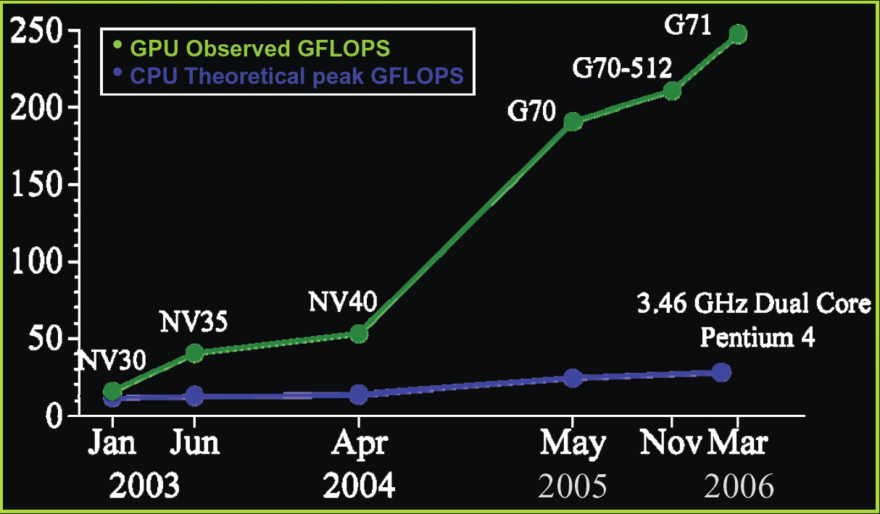
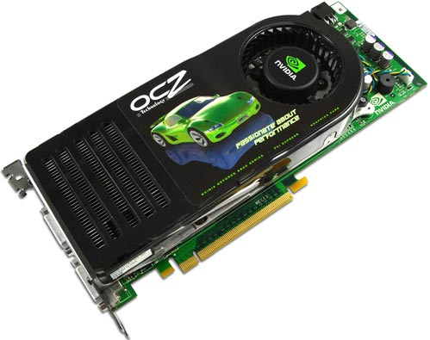
The nVidia G80 GPU
128 streaming floating point processors @1.5Ghz
1.5 Gb Shared RAM with 86Gb/s bandwidth
500 Gflop on one chip (single precision)

Slide 22
Why are GPU’s so fast?
Entertainment Industry has driven the economy of these chips?
  Males age 15-35 buy
  $10B in video games / year
Moore’s Law ++
Simplified design (stream processing)
Single-chip designs.

Slide 23
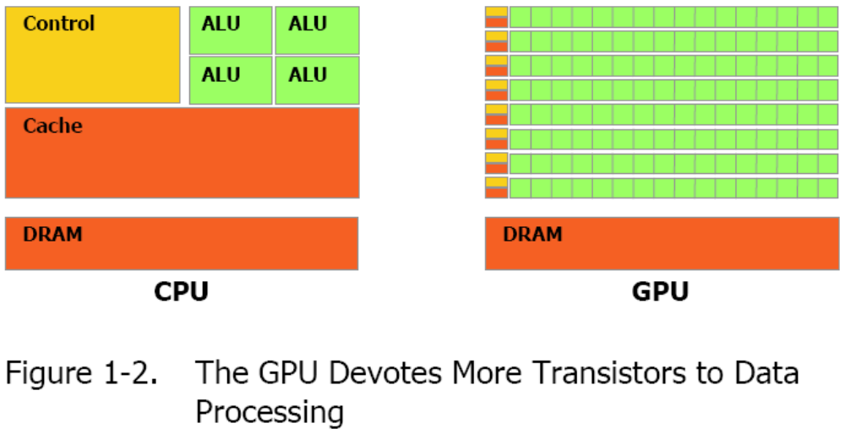
Modern GPU has more ALU’s

Slide 24
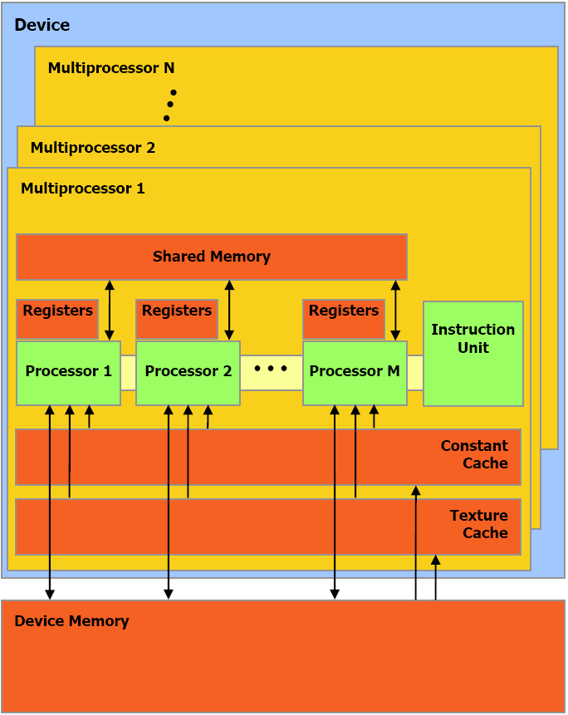
nVidia G80 GPU Architecture Overview
16 Multiprocessors Blocks
Each MP Block Has:
  8 Streaming Processors (IEEE 754 spfp compliant)
  16K Shared Memory
  64K Constant Cache
  8K Texture Cache
Each processor can access all of the memory at 86Gb/s, but with different latencies:
Shared – 2 cycle latency
Device – 300 cycle latency

Slide 25
A Specialized Processor
Very Efficient For
  Fast Parallel Floating Point Processing
  Single Instruction Multiple Data Operations
  High Computation per Memory Access
Not As Efficient For
  Double Precision
  Logical Operations on Integer Data
  Branching-Intensive Operations
  Random Access, Memory-Intensive Operations

Slide 26
Implementation = abstraction (from lecture 2)
Application
Application
Data Assembler
Setup / Rstr / ZCull
Vertex assembly
Vtx Thread Issue
Prim Thread Issue
Frag Thread Issue
Vertex operations
SP
SP
SP
SP
SP
SP
SP
SP
SP
SP
SP
SP
SP
SP
SP
SP
Primitive assembly
Thread Processor
Primitive operations
TF
TF
TF
TF
TF
TF
TF
TF
L1
L1
L1
L1
L1
L1
L1
L1
Rasterization
Fragment operations
L2
L2
L2
L2
L2
L2
FB
FB
FB
FB
FB
FB
Framebuffer
NVIDIA GeForce 8800
OpenGL Pipeline
Source : NVIDIA

Slide 27
Correspondence (by color)
Fixed-function assembly processors
Application-programmable parallel processor
Application
Application
Data Assembler
this was missing
Setup / Rstr / ZCull
Vertex assembly
Vtx Thread Issue
Prim Thread Issue
Frag Thread Issue
Vertex operations
SP
SP
SP
SP
SP
SP
SP
SP
SP
SP
SP
SP
SP
SP
SP
SP
Primitive assembly
Thread Processor
Primitive operations
TF
TF
TF
TF
TF
TF
TF
TF
L1
Fixed-function framebuffer operations
L1
L1
L1
L1
L1
L1
L1
Rasterization
(fragment assembly)
Fragment operations
L2
L2
L2
L2
L2
L2
FB
FB
FB
FB
FB
FB
Framebuffer
NVIDIA GeForce 8800
OpenGL Pipeline

Slide 28
Overview
Before graphics-programming APIs were introduced, 3D applications issued their commands directly to the graphics hardware
  Fast
  Became infeasible with increasing graphics hardware
Graphics APIs like DirectX and OpenGL act as a middle layer between the application and the graphics hardware
Using this model, applications write one set of code and the API does the job of translating this code to instructions that can be understood by the underlying hardware
A product of detailed collaboration among
  Application developers
  Hardware designers
  API/runtime architects

